Slide 1

Artificial Intelligence Based Network Management
Ivan’s initial survey
16.08.18

Slide 2
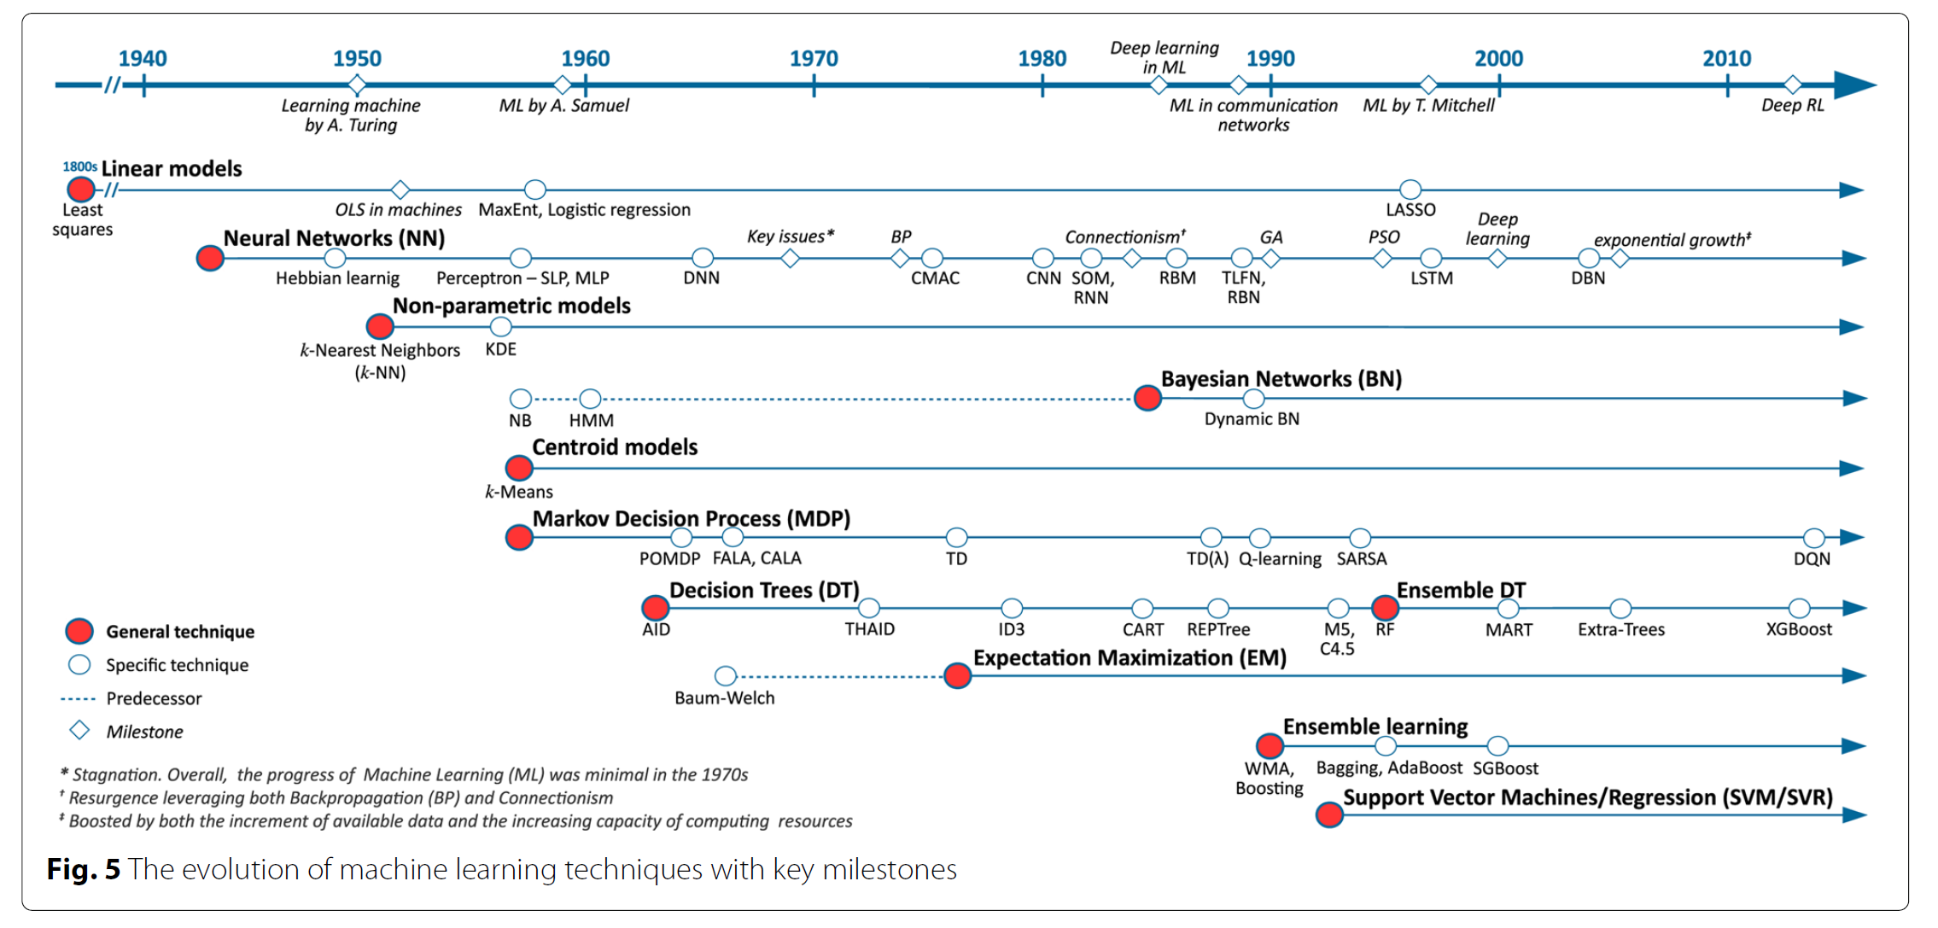
The evolution of AI
R. Boutaba, M. A. Salahuddin, N. Limam, S. Ayoubi, N. Shahriar, F. Estrada-Solano, and O. M. Caicedo, “A comprehensive survey on machine learning for networking: evolution, applications and research opportunities,” Journal of Internet Services & Applications, vol. 9, no. 1,p. 16, 2018.

Slide 3
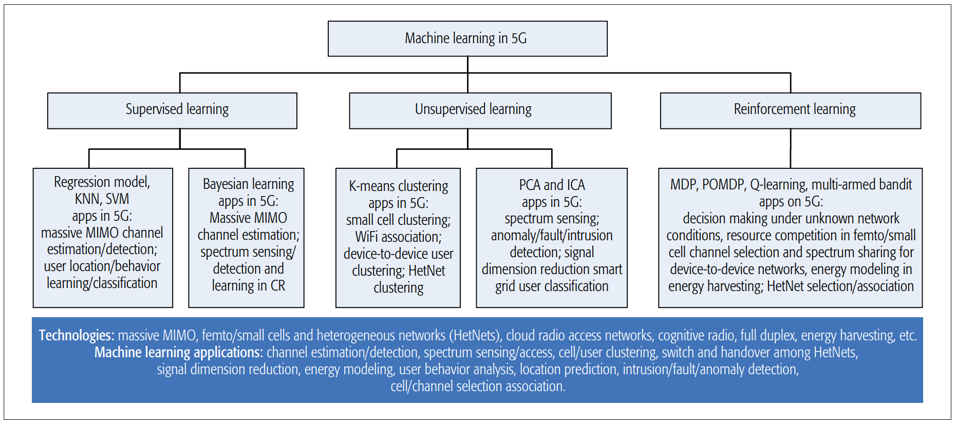
Classification form the perspective of AI
C. Jiang, H. Zhang, Y. Ren, Z. Han, K. C. Chen, and L. Hanzo, “Machine learning paradigms for next-generation wireless networks,” IEEE Wireless Communications, vol. 24, no. 2, pp. 98–105, 2017.

Slide 4
Classification form the perspective of NM
NM
configuration
accounting
performance
Fault
security
I.-T. R. M.3400, “Tmn management functions,” 1992.
G. P. Kumar and P. Venkataram, “Artificial intelligence approaches to network management: recent advances and a survey,” Computer Communications, vol. 20, no. 15, pp. 1313–1322, 1997.
S. Ayoubi, N. Limam, M. A. Salahuddin, N. Shahriar, R. Boutaba, F. Estrada-Solano, and O. M. Caicedo, “Machine learning for cognitive network management,” IEEE Communications Magazine, vol. 56, no. 1, pp. 158–165, 2018.

Slide 5
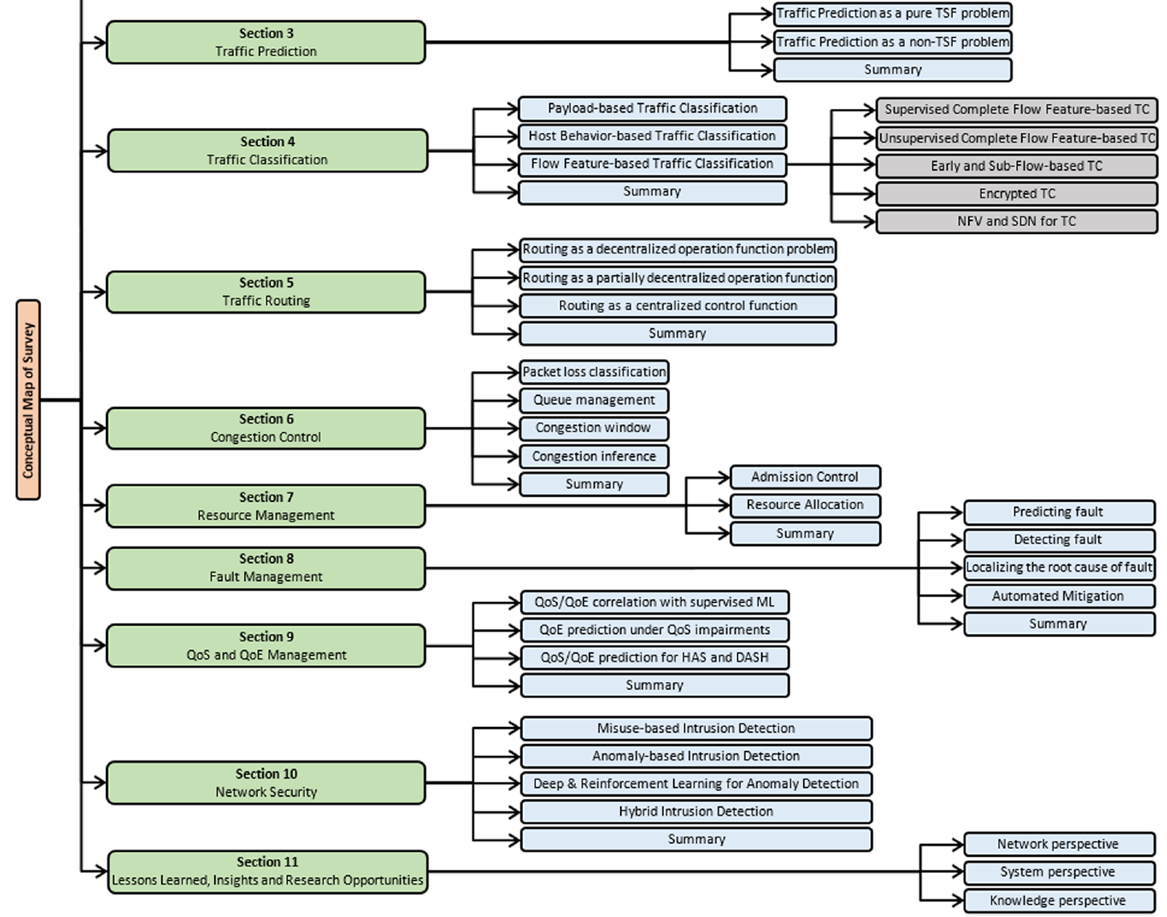
Other survey
R. Boutaba, M. A. Salahuddin, N. Limam, S. Ayoubi, N. Shahriar, F. Estrada-Solano, and O. M. Caicedo, “A comprehensive survey on machine learning for networking: evolution, applications and research opportunities,” Journal of Internet Services & Applications, vol. 9, no. 1, p. 16, 2018.

Slide 6

A Case of AI: Deep Q Learning
AI
SM
RL
UM
Sarsa
DQL
Q-Learning
Policy Gradients
Actor Critic
Monte Carlo
…

Slide 7
----RL

Slide 8
----Q Learning
Reword rules
State model
Action

Slide 9




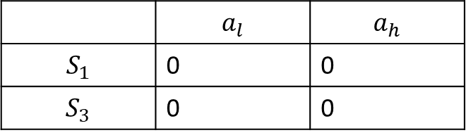
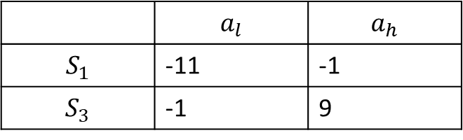
----Q Learning
Q-table
In addition
Gready policy
 | $$a_{l}$$ | $$a_{h}$$
$$S_{1}$$ | -11 | -1
$$S_{3}$$ | -1 | 9
1
2
3
4
Q-table
Reword rules
1. Walk each step -1
2. Meet Skull -10
3. Capture insect +10
 | $$a_{l}$$ | $$a_{h}$$
$$S_{1}$$ | 0 | 0
$$S_{3}$$ | 0 | 0

Slide 10
----Deep Q Learning

Slide 11
----NM

Slide 12
Thank you
Ivan
14.08.18

